Slide 1
fake job prediction analysis

Slide 2
Mentor name:-
1) Mrs Vibha
Group members :-
1) Anirudh Dyaga
2)Sai kumar Gandla
3)Yashwanth raj Gudise
4) Sitaroj Anilkumar
5) Sravan Kumar Reddy
6) Venkat Rohith Kandula

Slide 3

Project overview:-
Currently, the world is facing un-precedented times hence the graph of economy is suffering.
If a country is facing a recession, then the un-employment rate will increase.
Amidst of such high unemployment rates there exists another problem, “Fake jobs”.
Fake job postings are dangerous, as most of the unemployed would be desperate to apply for all the jobs they come across.
While applying for such jobs the applicants will eventually give in their valuable data which includes date of birth, bank account details and education details.
This is a dangerous problem that can be addressed through Machine Learning techniques and Natural Language Processing (NLP).

Slide 4

It is not that hard to find the real jobs among the fake ones. Even in our data we have only 5% of data that are turned out to be fake. It reveals more than Imbalanced data, people are aware of the consequences through law once get caught, less percentage also indicates there are less practise.
One thing that will help is doing a proper research about the company, now we have various social networking sites like linked in and Facebook, which helps you to access the job news from the respected company profile in those sites.
Many people are falling prey to these scammers because of the desperation that is caused by an unprecedented incident.

Slide 5
Table of variables:-
No | Variable | Datatype | Description
1. | Job_id | int | Identification number given to each job posting
2. | title | text | A name that describes the position or job
3. | location | text | Information about where the job is located
4. | department | text | Information about the department this job is offered by
5. | salary_range | text | Expected salary range
6. | company_profile | text | Information about the company
7. | description | text | A brief description about the position offered
8. | requirements | text | Pre-requisites to qualify for the job
9. | benefits | text | Benefits provided by the job

Slide 6
No | Variable | Data type | Description
10. | telecommuting | bool | Is work from home or remote work allowed
11. | has_company_logo | bool | Does the job posting have a company logo
12. | has_questions | bool | Does the job posting have any questions
13. | employment_type | text | 5 categories – Full-time, part-time, contract, temporary and other
14. | required_experience | text | Can be – Internship, Entry Level, Associate, Mid-senior level, Director, Executive or Not Applicable
15. | required_education | text | Can be – Bachelor’s degree, high school degree, unspecified, associate degree, master’s degree, certification, college coursework, professional, high school coursework, vocational
16. | Industry | text | The industry the job posting is relevant to
17. | Function | text | The umbrella term to determining a job’s functionality
18. | Fraudulent | text | The target variable à 0: Real, 1: Fake

Slide 7

Data Cleaning:-
Dropping the column "salary range" , ”Department” because they have more null column we have “country code”, “state code values and dropping unwanted column ‘job id’.
In the 'Location'” & “city name”. We are extracting city name from it and store it in a new column “city”.
In city we have more number of unique vales for this we did label encoding.

Slide 8

null imputation and encoding:-
Filled the columns “function”, “industry”, “employment type” by using mode imputation.
Filled the columns “required education”, “required experience” with “unspecified” and “not applicable” respectively
And all the other text columns nulls are replaced with empty spaces (“ “) for NLP purpose.
For 'required_education’, ’function’, 'required_experience‘, ‘employment_type’, this columns we did dummy encoding.
Label encoding for ‘industry’ column

Slide 9
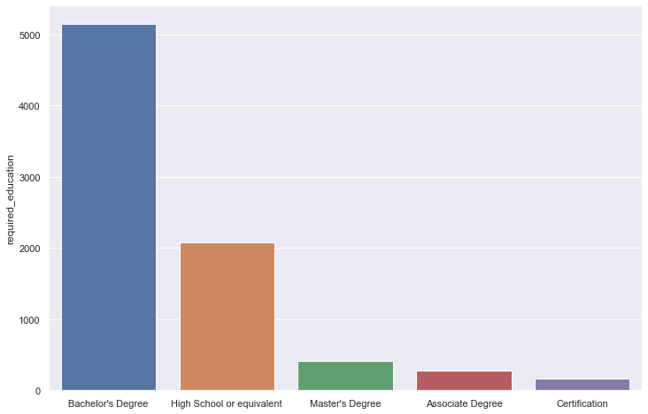
Count plot for “required education” (to have some glance on the data in the column )

Slide 10
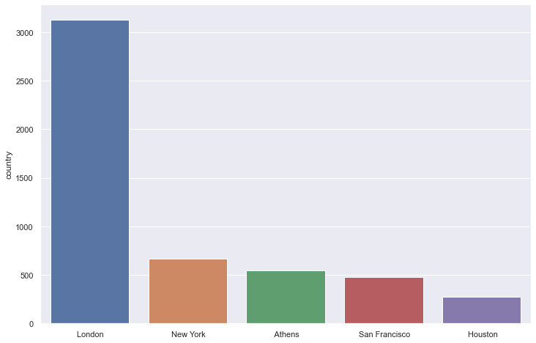
Count plot for “City” column (to have some glance on the data in the column)

Slide 11
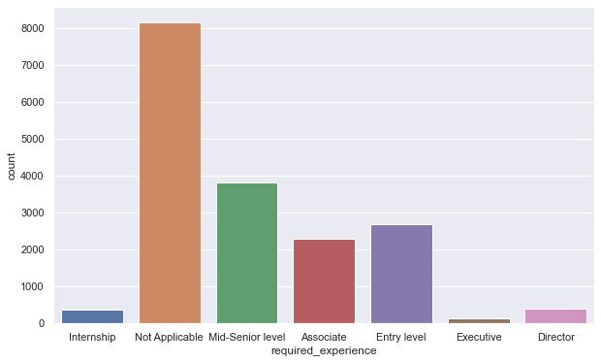
Count plot for “required experience” ( to have some glance on the data in the column )

Slide 12

Natural language processing:-
To perform natural language processing, we combined all the text columns (title, company profile, description, requirements, benefits ) into a single column
Then cleaned all the data and then removed all the stop words and also removed all the single letter words

Slide 13
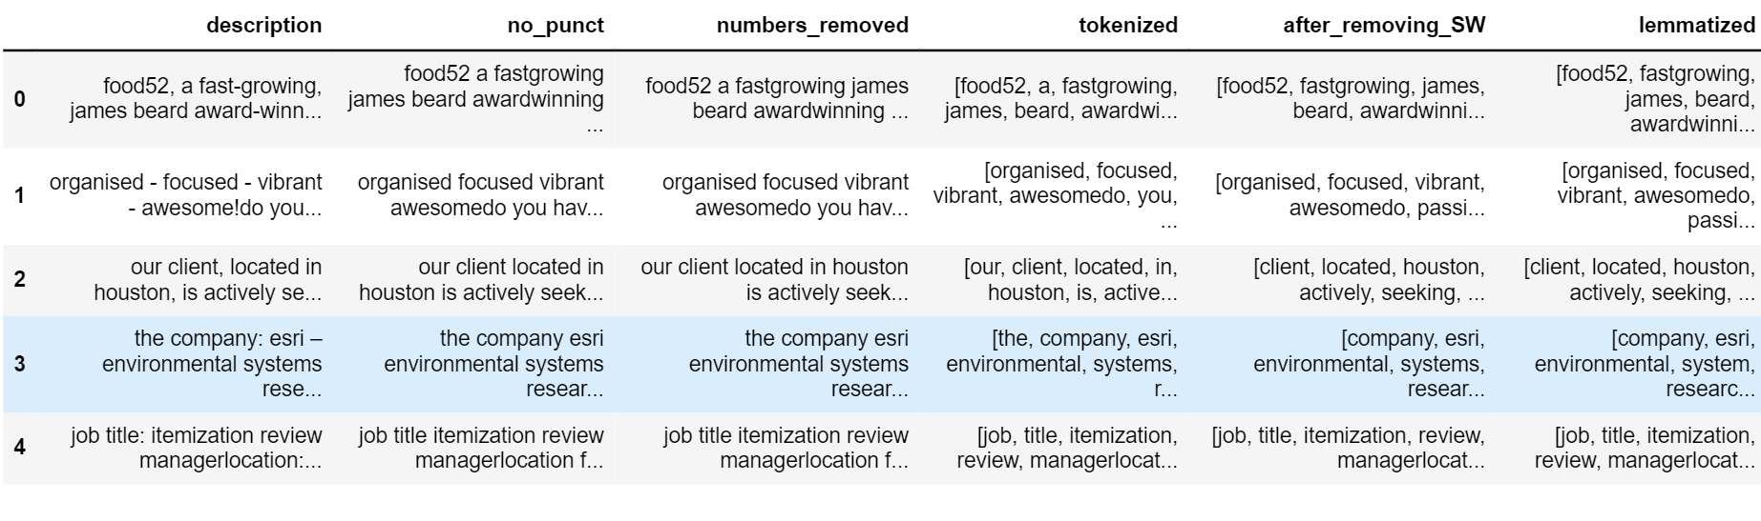
Nlp on “description” column:-
This data frame consists, a step by step approach we followed in text processing, that includes: removing punctuations, removing numbers, tokenization, removing stop words and lemmatization.

Slide 14
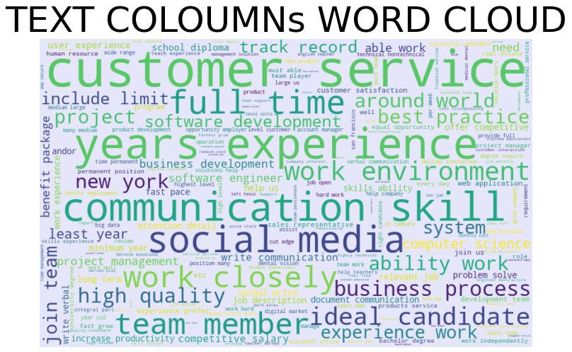
This word cloud represents the data from all the 5 text columns

Slide 15
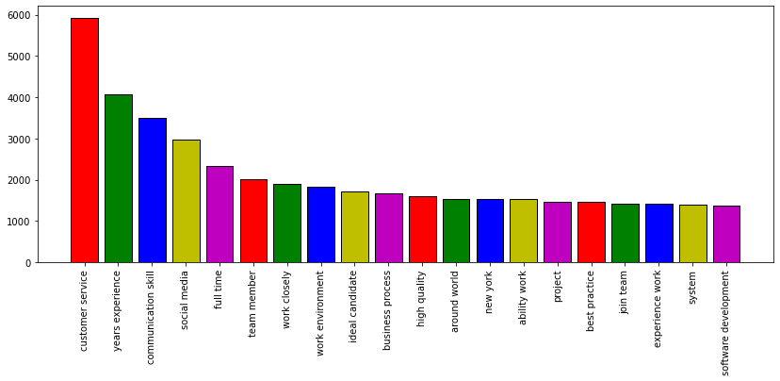
Top 20 words from the world cloud:-

Slide 16
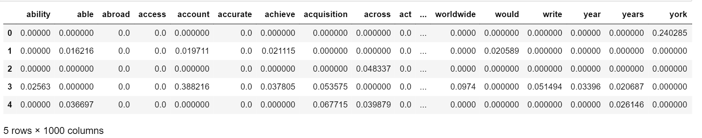
TFIDF:-
Vectorization is a process of converting text into numerical presentation using different methods.
TF-IDF, which stands for term frequency inverse document frequency, is a scoring measure widely used in information retrieval (IR) or summarization.
TF-IDF is intended to reflect how relevant a term is in a given sentence. The main purpose of TFIDF is to highlight words which are frequent in a sentence but not across sentences.
we have taken the 1000 words from the 5 text columns

Slide 17
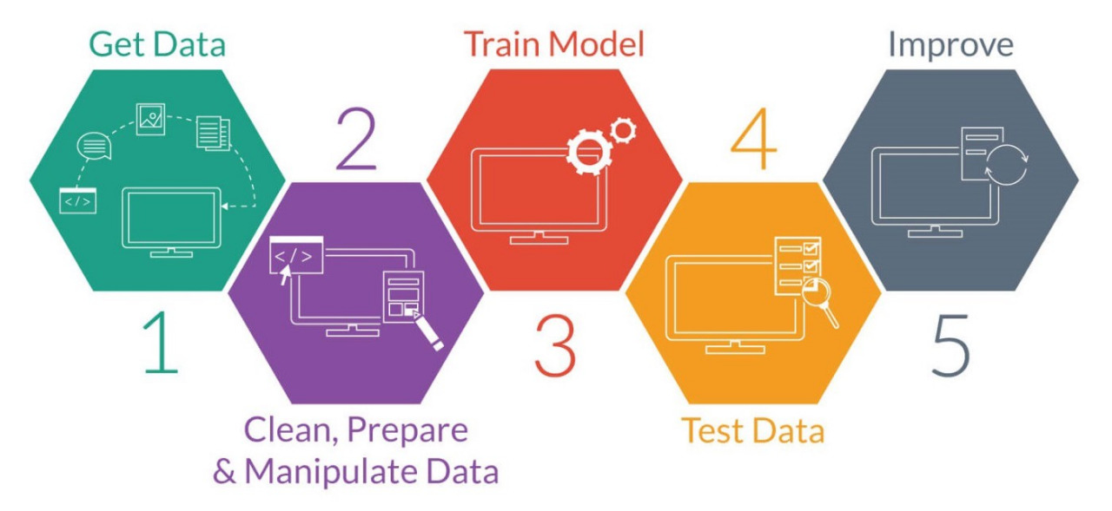
Model building:-
For modeling, we have gone through three different approaches such as:-
1) only text columns,
2)skipping the text columns,
3)the whole dataset.
In all three approaches, we used three different algorithms and to finalize the best of the rest.
The algorithms that are used: KNN, Randomforest, Logistic regression.

Slide 18
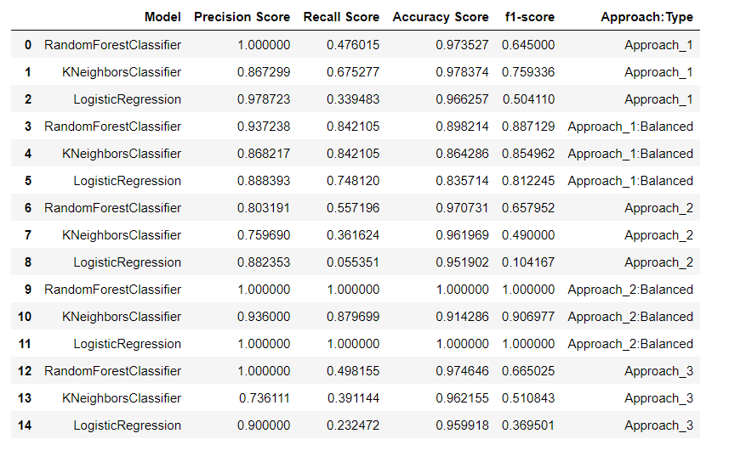
The following table represents the score for all the 3 approaches:-

Slide 19
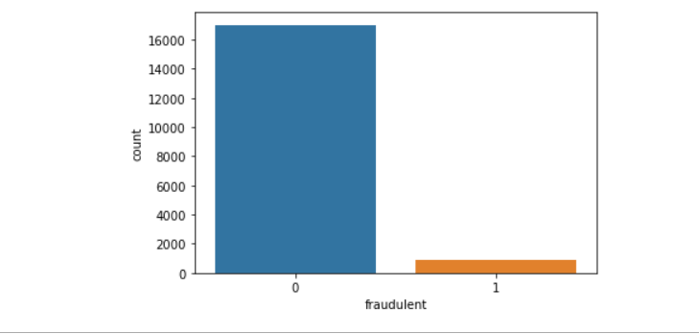
Improvisation:-
Since the approaches 1 has the highest score among all the approaches.
So, we will fine tune the approach to get the better results, we use following techniques like smote- to balance the data and SFS- for feature selection
Target variable is highly imbalanced

Slide 20
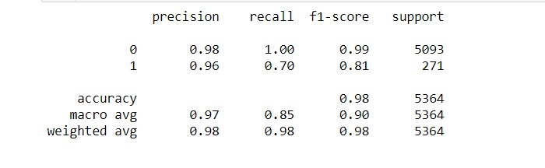
Final model score:-
Improving the model:
Basically, a classification model with imbalanced dataset is lenient towards the majority class. Here the percentage is 95%: 5%, in favour of true jobs. We use under sampling or over sampling, which returns balanced data. Here we use, Synthetic Minority Oversampling Technique (SMOTE) which is a very popular oversampling to improve the score.

Slide 21
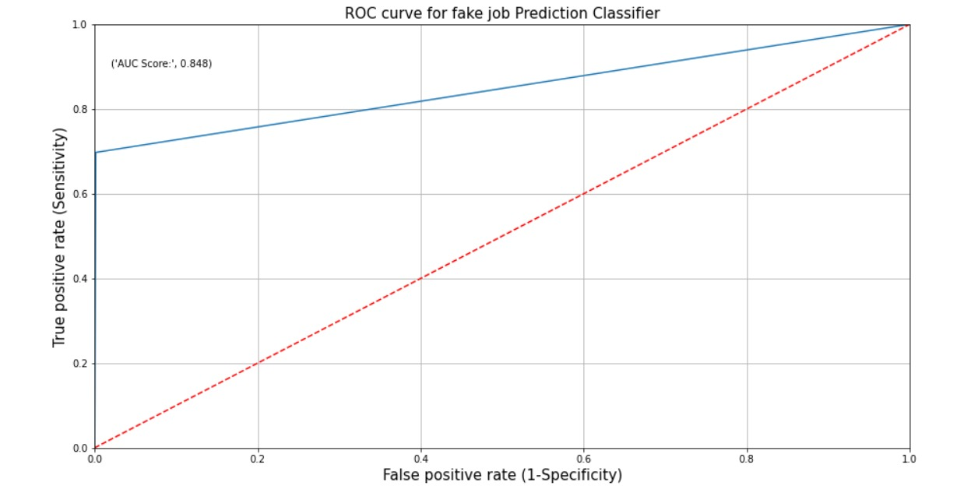
ROC auc curve for final model:-

Slide 22
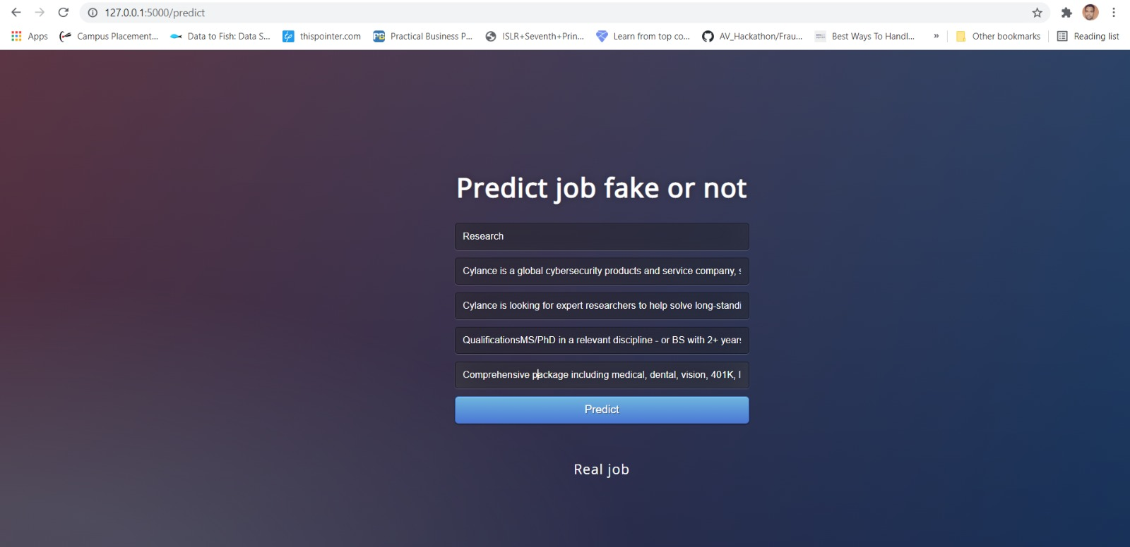
Project deployment:-
Model deployment:
To use the model for real time data deploy the model and let the model take the dynamic inputs from various stakeholders to help them predict the job credibility. This model urges users to take a final call based upon the output generated by the model.

Slide 23


